Slide 1
Monte Carlo Simulation
Gomoku Prediction
Xianzhuo Cao

Slide 2
Content：
Introduction to Gomoku
The purpose of the prediction
The algorithm of AI
How to apply Monte Carlo Simulation to Gomoku
The influential factors that will affect the result
The expected result
The significance of this prediction
Notes:
The Algorithm of the

Slide 3
How does Gomoku Work
Gomoku is an abstract strategy board game
There are white stones and black stones. Players alternate turns placing a stone of their color on an empty intersection. The winner is the first player to form an unbroken chain of five stones horizontally, vertically, or diagonally.
The Gomoku board is 15X15.
—Wikipedia

Slide 4
The Purpose of This Prediction：
Figure out which steps make the most important significant influence on the result.
Figure out the essence of the Gokudo principle.
Simulate the Gokudo AI operation principle.

Slide 5

Gomoku & Monte Carlo Simulation
Monte Carlo is a process of doing large quantity of sampling.
We can apply Monte Carlo Simulation to the Gomoku to find out some rules.

Slide 6
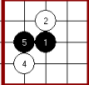
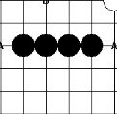
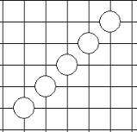
The Algorithm of the AI
We set different score principles for each shape of stones.
  Ex. The scores for each of these three: 50, 50000, infinity

Slide 7
The Algorithm of the AI
We set different score principles for each shape of stones.
shape_score = [(50, (0, 1, 1, 0, 0)),(50, (0, 0, 1, 1, 0)),
(200, (1, 1, 0, 1, 0)),(500, (0, 0, 1, 1, 1)),
(500, (1, 1, 1, 0, 0)),(5000, (0, 1, 1, 1, 0)),
(5000, (0, 1, 0, 1, 1, 0)),(5000, (0, 1, 1, 0, 1, 0)),
(5000, (1, 1, 1, 0, 1)),(5000, (1, 1, 0, 1, 1)),
(5000, (1, 0, 1, 1, 1)),(5000, (1, 1, 1, 1, 0)),
(5000, (0, 1, 1, 1, 1)),(50000, (0, 1, 1, 1, 1, 0)),
(99999999, (1, 1, 1, 1, 1))]

Slide 8
The Algorithm of the AI
Here we apply Game Tree to search for the best solution.
The depth of the tree can be set up. The bigger the number is, the smarter the AI will be, and the time consumption will also grow exponentially.

Slide 9
The Algorithm of the AI
The theory is to try out all possibilities for the next steps and to find out the biggest score. The depth of the tree means how many moves the AI will calculate.
  Ex: if the depth is 2, the AI will find out the biggest score of yours minus your enemy’s next move. It means predicting two moves.

Slide 10
How to Apply the Monte Carlo
Basically the idea is to use the Gomoku AI to play against each other for thousands of times.
Here I set the depth of the tree as 1 because of the time complexity.

Slide 11
How to Apply the Monte Carlo
Then the problem is lacking of randomness. Two AIs will eventually end up with the same way every time.
Therefore, I redesign the AI by using a random function to choose one of the three moves of biggest scores randomly.
In addition, I optimise the algorithm by pruning the tree.

Slide 12
Influential Factors & Expected Result
Gomoku board size: 15X15; 13X13; 11X11
  Expected result: The smaller the board size is, the better the AI works
Make the first move in different places:
  Expected result:
    The player who makes the first move tends to win.
    First moves around the board center has a higher possibility than away from the board center

Slide 13
Influential Factors & Expected Result
Parameter weighting factor
  Change the principles of the score of different shapes.
Change the rules of the game.
  Ex. Four stones in a row.
    Result: the one with the first move will always win
  Ex. Six stones in a row
    Result: most of the games will end up in tie

Slide 14
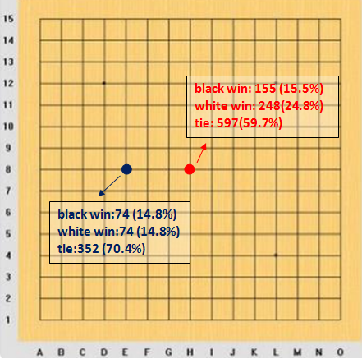
Results so far

Slide 15
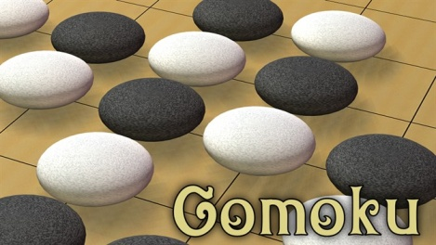
What I have Learned from this Project
How do we design the AI in Python
How user interface and graphs are designed in Python
How to use Monte Carlo Simulation to generate rules.

Slide 16
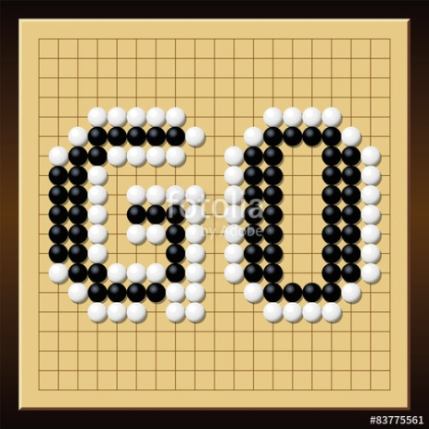
The Significance of this Prediction
We have tested and verified some basic rules in Gomoku by using Monte Carlo Simulation

Slide 17

Thanks!

